Slide 1
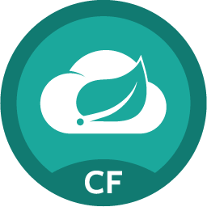
Pivotal follow-up Workshops
Please visit the Pivotal booth for details. Free for first 50 registrants!
CD with Concourse
Let's use Spring Cloud Pipeline and Concourse to put it all together and get to production - safely, repeatedly, and often.
The Java Buildpack, 12 Factor apps
Essentials and basics for Java apps on PCF - part 2 to Cloud Native Java. We’ll dive deeper into the question: “I could use Docker with PCF but why would I want to when we have buildpack?”
Cloud Native .NET Workshop
Using Spring Cloud Services, Steeltoe, and PCF with .NET to implement service discovery, circuit breaker, externalized config.
Data Services with PCF: Connectors, MySQL, RabbitMQ, Gemfire, nice compliment to SCDF workshop: "great, you have a microservice / app / data flow, now it needs the actual data”
Unhook yourself from your Dad’s ESB: Continuously build integration patterns using a microservices based approach with SCDF and Concourse.
Supercharge your Microservices: Performance and scalability are top concerns for microservices responsible for data. Waiting for round trip to a database may not be good enough. In this session you will implement data microservices using Spring and Pivotal Cloud Cache
Notes:
We did a threat modelling exercise on the netflixoss components,
Check SCS 1.0 blog post for MITM details.
SCS creates a UAA Identity Zone.

Slide 2
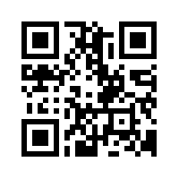
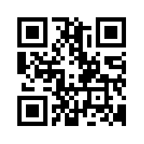
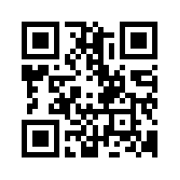
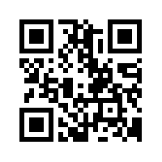
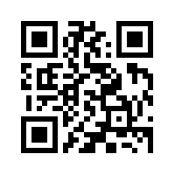
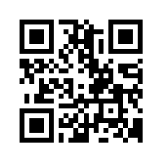
CD With Concourse
Java Buildpack, 12 Factor apps
Cloud Native .NET Workshop
Data Services with PCF
Unhook yourself from your Dad’s ESB
Supercharge your Microservices

